Slide 1

NO PHISHING ZONE
Milestone 2
ADAM MILLS
DYLAN REDDEN
CHRIS SCHMITT
DENNIS UGBEBOR

Slide 2
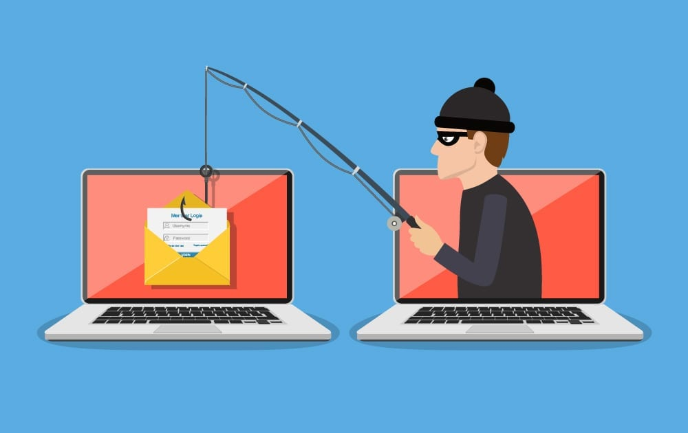
Reminder - What are we?
Goal: Safe-browsing enhancement tool for average user
Premise: Average user might not have
Cybersecurity Awareness training/exposure
Proficient understanding of the tool (webmail) they’re using
Access to methods for improvement
Notes:
Goal: a tool that helps users see malicious links in their emails, that they otherwise may not see.
Target audience is the a casual internet user who may not know what danger signs to look for in an email, because they lack … *read premise points*

Slide 3
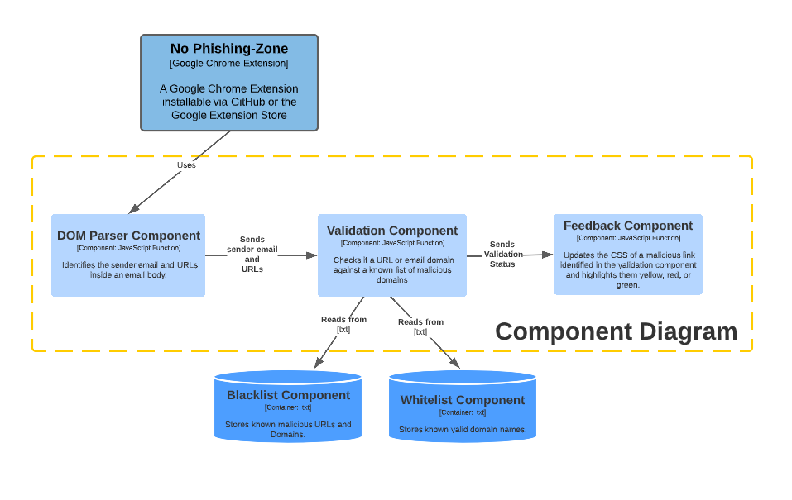
Prototype Structure
Notes:
Email page is loaded up by Chrome browser.
Program waits a short period of time to allow page to fully load (avoiding race instance).
DOM is parsed and URLs inside email body are read into the program.
Found URLs are then compared against the Blacklist (known bad URLs), and then the Whitelist (user/program approved/safe URLs).
A validation status is sent to the CSS of the email for the outcome of the comparison for the user to see.
Red for “dangerous”.
Yellow for “unknown”.
Green for “safe”.

Slide 4
Development
Accomplishments
Difficulties
Functioning Chrome Extension
Extension ingests:
Sender Email Address
Sender Name
URLs in Body of Email
Functions:
Manipulate CSS of web page
Validate Senders email address
High levels of obfuscation
Navigating tree structures
Incompatibility between different browser-based web clients
Email validation
Domain and address whitelists
General lack of exposure to web development

Slide 5
Risk Assessment - Did it change?
Limited project timeline
Web Development Woes
Can the team come together to reach the finish line?
Product ineffectiveness
Changes to the Chrome development environment
Notes:
Talk about how overall just slight changes. Limited project timeline for our original scope became more likely, the likelihood that the chrome extension code ecosystem or ruleset would dramatically change looks to be not likely at all anymore but the impact would still be high.

Slide 6

Environment Setup
Clone our No Phishing Zone repository
Open Google Chrome
Navigate to chrome://extensions/
Enable Developer Mode
Select Unpack Extension
Select the No Phishing Zone folder you cloned into your github folder
Once the extension is enabled navigate to a Google Mail (Gmail) Account and open an email
Notes:
https://github.com/amills93/No-Phishing-Zone#Environment-Setup

Slide 7

Live Demonstration

Slide 8

QUESTIONS? FEEDBACK?

